Slide 1
Parallel and Perpendicular Lines
Geometry
Chapter 3
Notes:
Geometry 3

Slide 2
This Slideshow was developed to accompany the textbook
  Big Ideas Geometry
  By Larson and Boswell
  2022 K12 (National Geographic/Cengage)
Some examples and diagrams are taken from the textbook.
Slides created by
Richard Wright, Andrews Academy
rwright@andrews.edu

Slide 3
3.1 Pairs of Lines and Angles
Objectives: By the end of the lesson,
• I can identify lines and planes.
• I can identify parallel and perpendicular lines.
• I can identify pairs of angles formed by transversals.

Slide 4
3.1 Pairs of Lines and Angles
Parallel Lines ||
Lines that do NOT intersect and are coplanar
Lines go in the same direction
Skew Lines
Lines that do NOT intersect and are on different planes
Lines go in different directions

Slide 5
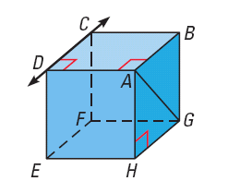
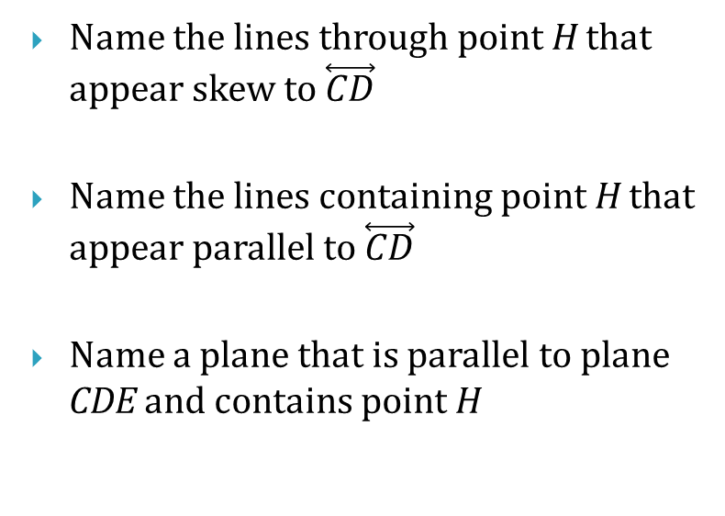
3.1 Pairs of Lines and Angles
Name the lines through point H that appear skew to $\overset{⃡}{CD}$
Name the lines containing point H that appear parallel to $\overset{⃡}{CD}$
Name a plane that is parallel to plane CDE and contains point H
Notes:
AH, EH
GH
BGH

Slide 6
3.1 Pairs of Lines and Angles
In a plane, two lines are either
  Parallel
  Intersect
Parallel Postulate
If there is a line and a point not on the line, then there is exactly one line through the point parallel to the given line.
Perpendicular Postulate
If there is a line and a point not on the line, then there is exactly one line through the point perpendicular to the given line.

Slide 7
3.1 Pairs of Lines and Angles
Transversal
Line that intersects two coplanar lines
Interior ∠
angles that are between the lines
1
∠2, ∠3, ∠5, ∠6
4
2
3
Exterior ∠
5
6
angles that are outside of the lines
8
7
∠1, ∠4, ∠7, ∠8

Slide 8
3.1 Pairs of Lines and Angles
Alternate interior angles
interior angles on opposite sides of the transversal
∠2 and ∠5, ∠3 and ∠6
1
4
2
Alternate exterior angles
3
exterior angles on opposite sides of the transversal
5
6
∠1 and ∠8, ∠4 and ∠7
8
7

Slide 9
3.1 Pairs of Lines and Angles
Consecutive interior angles
interior angles on the same side of the transversal
∠2 and ∠6, ∠3 and ∠5
1
4
2
Corresponding angles
3
angles on the same location relative to the transversal
5
6
∠1 and ∠6, ∠2 and ∠7,
∠3 and ∠8, ∠4 and ∠5
8
7

Slide 10
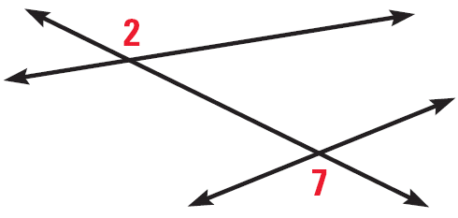
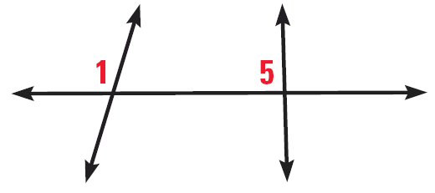
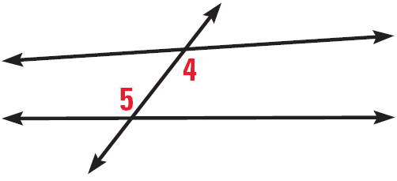
3.1 Pairs of Lines and Angles
Classify the pair of numbered angles
125 #2, 4, 6, 8, 9, 10, 11, 12, 14, 15, 16, 20, 21, 22, 24, 28, 32, 33, 35, 36 = 20 total
Notes:
Corresponding
Alternate Exterior
Alternate Interior

Slide 11
3.2 Parallel Lines and Transversals
Objectives: By the end of the lesson,
• I can use properties of parallel lines to find angle measures.
• I can prove theorems about parallel lines.

Slide 12
3.2 Parallel Lines and Transversals
Draw parallel lines on a piece of notebook paper, then draw a transversal.
Use the protractor to measure all the angles.
What types of angles are congruent?
  (corresponding, alt interior, alt exterior)
How are consecutive interior angles related?
  (supplementary)

Slide 13
3.2 Parallel Lines and Transversals
Corresponding Angles Postulate
If 2 || lines are cut by trans., then the corrs ∠ are ≅
Alternate Interior Angles Theorem
If 2 || lines are cut by trans., then the alt int ∠ are ≅
Alternate Exterior Angles Theorem
If 2 || lines are cut by trans., then the alt ext ∠ are ≅
Consecutive Interior Angles Theorem
If 2 || lines are cut by trans., then the cons int ∠ are supp.

Slide 14
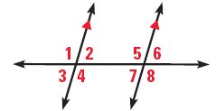
3.2 Parallel Lines and Transversals
If m∠1 = 105°, find m∠4, m∠5, and m∠8. Tell which postulate or theorem you use in each case
If m∠3 = 68° and m∠8 = (2x + 4)°, what is the value of x?
Notes:
m∠4 = 105; vertical angles are congruent
m∠5 = 105; corresponding angles postulate
m∠8 = 105; alt ext angles theorem
m∠3 = m∠2
m∠8 = m∠5
∠2 and ∠5 are cons int angles and are supp
m∠2 + m∠5 = 180
m∠3 + m∠8 = 180
68 + 2x + 4 = 180
2x + 72 = 180
2x = 108
x = 54

Slide 15
3.2 Parallel Lines and Transversals
Prove that if 2 || lines are cut by a trans, then the ext angles on the same side of the trans are supp.
Given: p || q
Prove: ∠1 and ∠2 are supp.
ℓ
q
1
3
p
2
Statements
Reasons
Notes:
p || q (given)
m∠1 + m∠3 = 180 (linear pair post)
∠2 ≅ ∠3 (corrs angles post)
m∠2 = m∠3 (def ≅)
m∠1 + m∠2 = 180 (substitution)
∠1 and ∠2 are supp (def supp)

Slide 16
3.2 Parallel Lines and Transversals
131 #2, 4, 5, 6, 8, 10, 12, 14, 15, 18, 20, 22, 23, 24, 26, 29, 30, 32, 33, 38 = 20 total

Slide 17
3.3 Proofs with Parallel Lines
Objectives: By the end of the lesson,
• I can use theorems to identify parallel lines.
• I can prove theorems about identifying parallel lines.

Slide 18
3.3 Prove Lines are Parallel
Corresponding Angles Converse
If 2 lines are cut by trans. so the corrs ∠ are ≅, then the lines are ||.
Alternate Interior Angles Converse
If 2 lines are cut by trans. so the alt int ∠ are ≅, then the lines are ||.
Alternate Exterior Angles Converse
If 2 lines are cut by trans. so the alt ext ∠ are ≅, then the lines are ||.
Consecutive Interior Angles Converse
If 2 lines are cut by trans. so the cons int ∠ are supp., then the lines are ||.

Slide 19
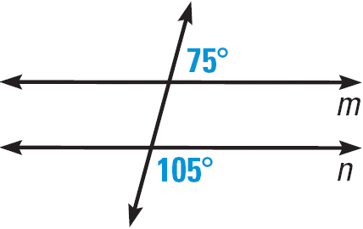
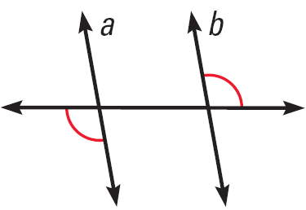
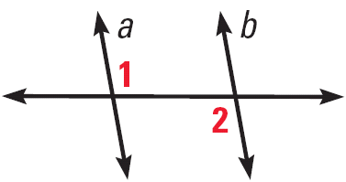
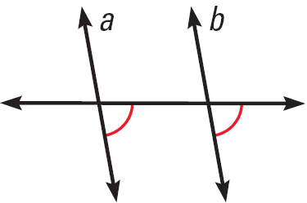
3.3 Prove Lines are Parallel
Is there enough information to conclude that m || n?
Can you prove that the lines are parallel? Explain.
m ∠1 + m ∠2 = 180°
Notes:
Yes, corresponding angles will both be 75°
Yes, alt ext angles converse
Yes, corres angles converse
No, should be ∠1 ≅ ∠2 by alt int angles converse

Slide 20
3.3 Prove Lines are Parallel
Transitive Property of Parallel Lines
If two lines are parallel to the same line, then they are parallel to each other.
Paragraph proofs
  The proof is written in sentences.
  Still need to have the statements and reasons.

Slide 21
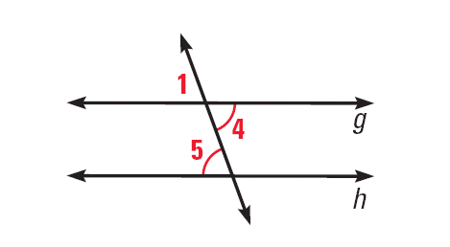
3.3 Prove Lines are Parallel
Write a paragraph proof to prove that if 2 lines are cut by a trans. so that the alt int ∠s are ≅, then the lines are ||.
Given: ∠4 ≅ ∠5
Prove: g || h
Notes:
It is given that ∠4 ≅ ∠5. By the vertical angle congruence theorem, ∠1 ≅ ∠4. Then by the Transitive Property of Congruence, ∠1 ≅ ∠5. So, by the Corresponding Angles Converse, g || h.

Slide 22
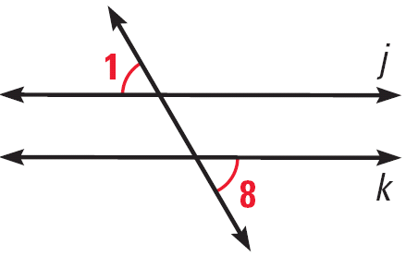
3.3 Prove Lines are Parallel
If you use the diagram at the right to prove the Alternate Exterior Angles Converse, what GIVEN and PROVE statements would you use?
138 #2, 4, 6, 10, 12, 14, 16, 20, 22, 24, 26, 28, 30, 32, 35, 39, 41, 44, 45, 49 = 20 total
Notes:
Given: ∠1 ≅ ∠8
Prove: j || k

Slide 23
3.4 Proofs with Perpendicular Lines
Objectives: By the end of the lesson,
• I can find the distance from a point to a line.
• I can prove theorems about perpendicular lines.

Slide 24
3.4 Proofs with Perpendicular Lines
Distance
From point to line: length of segment from point and ⊥ to line
Between two || lines: length of segment ⊥ to both lines

Slide 25

3.4 Proofs with Perpendicular Lines
Find the distance from point A to $\overset{⃡}{BC}$.
Notes:
Use the endpoints from the perpendicular segment (−4, 2) and (−1, 8)
Calculate distance $\sqrt{{\left(−1−\left(−4\right)\right)}^{2}+{\left(8−2\right)}^{2}}=\sqrt{3^{2}+{\left(6\right)}^{2}}=\sqrt{45}=3\sqrt{5}=6.7$

Slide 26
3.4 Proofs with Perpendicular Lines
Linear Pair Perpendicular Theorem
If two lines intersect to form a linear pair of congruent angles, then the lines are perpendicular.

Slide 27
3.4 Proofs with Perpendicular Lines
Perpendicular Transversal Theorem
If a trans. is ⊥ to 1 of 2 || lines, then it is ⊥ to the other.
Lines ⊥ to a Transversal Theorem
In a plane, if 2 lines are ⊥ to the same line, then they are || to each other.

Slide 28
3.4 Proofs with Perpendicular Lines
Prove the Perpendicular Transversal Theorem using the diagram and the Alternate Interior Angles Theorem.
Given: h || k, j ⊥ h
Prove: j ⊥ k
Statements
Reasons
Notes:
STATEMENTS REASONS
1. h || k, j ⊥ h 1. Given
2. m∠2 = 90° 2. Definition of perpendicular lines
3. ∠2 ≅ ∠3 3. Vertical Angles Congruence Theorem
4. ∠3 ≅ ∠6 4. Alternate Interior Angles Theorem
5. ∠2 ≅ ∠6 5. Transitive Property of Angle Congruence
6. m∠2 = m∠6 6. Definition of congruent angles
7. m∠6 = 90° 7. Substitution Property of Equality
8. j ⊥ k 8. Definition of perpendicular lines

Slide 29
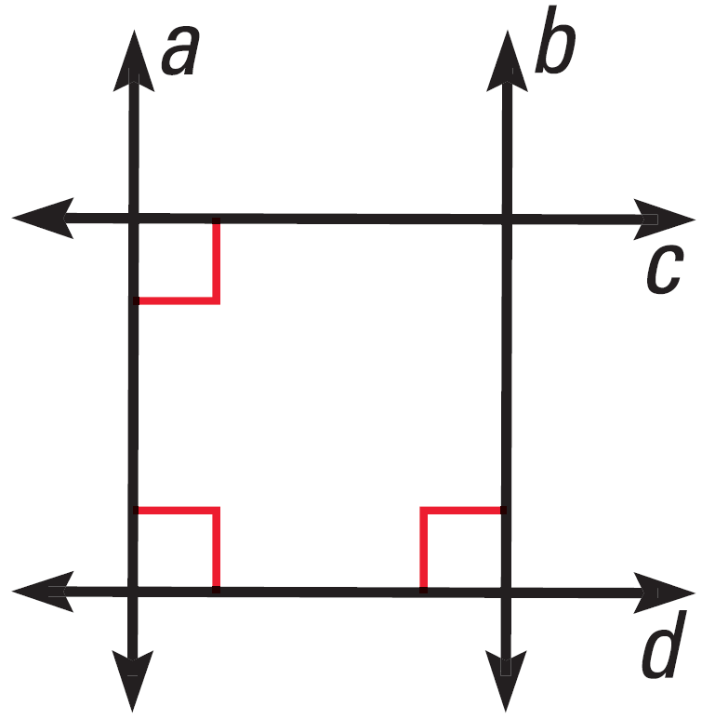
3.4 Proofs with Perpendicular Lines
Is b || a?
Is b ⊥ c?
146 #2, 10, 12, 14, 16, 18, 20, 21, 24, 26, 34, 40, 42, 45, 46 = 15 total
Notes:
Yes, lines perpendicular to transversal theorem
Yes, c || d by the lines ⊥ to trans theorem; b ⊥ c by the ⊥ trans theorem

Slide 30
3.5A Equations of Parallel and
Perpendicular Lines
Objectives: By the end of the lesson,
• I can partition directed line segments using slope.
• I can use slopes to identify parallel and perpendicular lines.

Slide 31
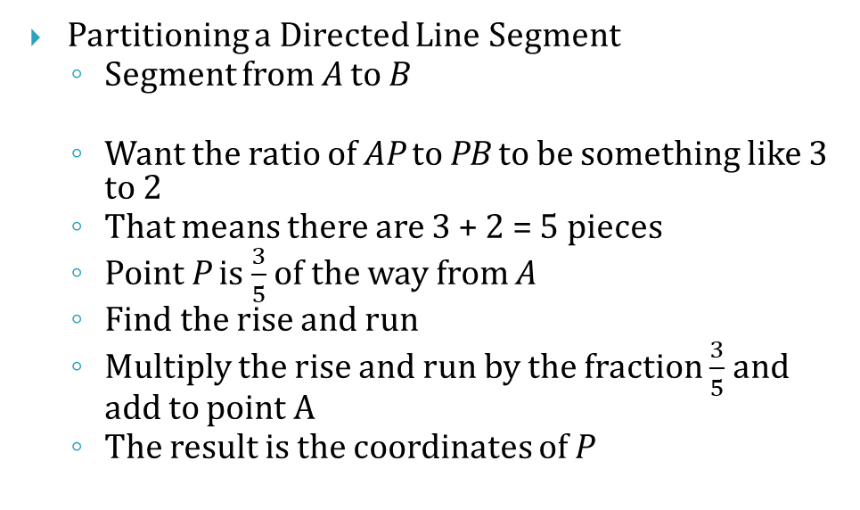
3.5A Equations of Parallel and
Perpendicular Lines
Partitioning a Directed Line Segment
  Segment from A to B
  Want the ratio of AP to PB to be something like 3 to 2
  That means there are 3 + 2 = 5 pieces
  Point P is $\frac{3}{5}$ of the way from A
  Find the rise and run
  Multiply the rise and run by the fraction $\frac{3}{5}$ and add to point A
  The result is the coordinates of P

Slide 32
3.5A Equations of Parallel and
Perpendicular Lines
Find the coordinates of point F along the directed line segment CD so that the ratio of CF to FD is 3 to 5.
Notes:
3 + 5 = 8
Fraction of line from C to F is 3/8
Rise = -8
Run = 12
$$x=x_{1}+fraction·run=−4+\frac{3}{8}\left(12\right)=0.5$$
$$y=y_{1}+fraction·rise=5+\frac{3}{8}\left(−8\right)=2$$
(0.5, 2)

Slide 33
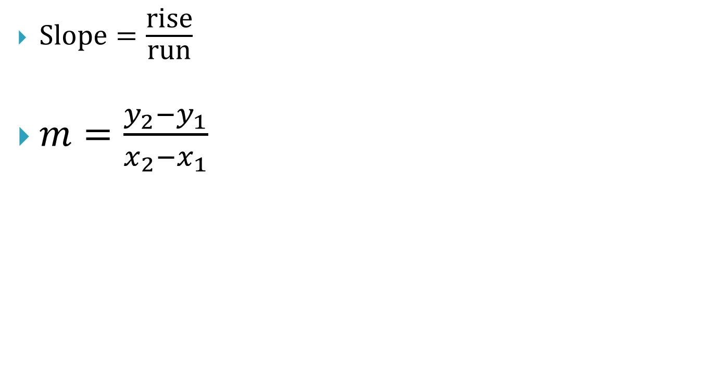
3.5A Equations of Parallel and
Perpendicular Lines
$\text{Slope}=\frac{\text{rise}}{\text{run}}$
$m=\frac{y_{2}−y_{1}}{x_{2}−x_{1}}$
(x₂, y₂)
rise
(x₁, y₁)
run

Slide 34
3.5A Equations of Parallel and
Perpendicular Lines
Positive Slope
  Rises
Zero Slope
  Horizontal
Negative Slope
  Falls
No Slope (Undefined)
  Vertical
0
+
–
No
There’s No Slope to stand on.

Slide 35
3.5A Equations of Parallel and
Perpendicular Lines
Slopes of Parallel Lines
In a coordinate plane, 2 nonvertical lines are parallel iff they have the same slope.
And, any 2 vertical lines are parallel.
m₁ = 2; m₂ = 2
Slopes of Perpendicular Lines
In a coordinate plane, 2 nonvertical lines are perpendicular iff the products of their slopes is -1.
Or, Slopes are negative reciprocals.
And, horizontal lines are perpendicular to vertical lines
m₁ = 2; m₂ = -½

Slide 36
3.5A Equations of Parallel and
Perpendicular Lines
Tell whether the lines are parallel, perpendicular, or neither.
  Line 1: through (–2, 8) and (2, –4)
  Line 2: through (–5, 1) and (–2, 2)
154 #1, 2, 3, 4, 5, 6, 7, 8, 9, 10, 53, 54, 57 = 13 total
Notes:
Line 1: (-4 – 8)/(2 – (-2)) → -12/4 → -3
Line 2: (2 – 1)/(-2 – (-5)) → 1/3
Perpendicular

Slide 37
3.5B Equations of Parallel and
Perpendicular Lines
Objectives: By the end of the lesson,
• I can write equations of parallel and perpendicular lines.
• I can find the distance from a point to a line.

Slide 38
3.5B Equations of Parallel and
Perpendicular Lines
Slope-intercept form of a line
  y = mx + b
    m = slope
    b = y-intercept
To write equations of lines using slope-intercept form
  Find the slope
  Find the y-intercept
    It is given or,
    Plug the slope and a point into y = mx + b and solve for b
  Write the equation of the line by plugging in m and b into y = mx + b

Slide 39
3.5B Equations of Parallel and
Perpendicular Lines
Write an equation of the line that passes through (1, 5) and is parallel to the line with the equation y = 3x – 5.
Notes:
m = 3 (parallel same slope)
$$y=mx+b$$
$$5=3\left(1\right)+b$$
$$b=2$$
$$y=3x+2$$

Slide 40
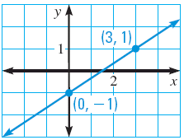
3.5B Equations of Parallel and
Perpendicular Lines
Write an equation of the line perpendicular to the line in the graph and passing through (3, 1).
Notes:
$$m_{given}=\frac{1−\left(−1\right)}{3−0}=\frac{2}{3}$$
$$m_{⊥}=−\frac{3}{2}$$
$$y=mx+b$$
$$1=\left(−\frac{3}{2}\right)3+b$$
$$1=−\frac{9}{2}+b$$
$$\frac{11}{2}=b$$
$$y=−\frac{3}{2}x+\frac{11}{2}$$

Slide 41
3.5B Equations of Parallel and
Perpendicular Lines
Find the distance from a point to a line
  Find the equation of the line perpendicular to the given line and passing through the point.
  Use a graph or system of equations to find where the lines intersect.
  Find the distance between the given point and the point of intersection.

Slide 42
3.5B Equations of Parallel and
Perpendicular Lines
Find the distance from the point (6, −2) to the line y = 2x − 4.
154 #12, 14, 16, 18, 20, 22, 24, 36, 38, 46, 62, 64 = 12 total
Notes:
Equation of Perpendicular line
$$m_{⊥}=−\frac{1}{2}$$
$$y=mx+b$$
$$−2=−\frac{1}{2}(6)+b$$
$$b=1$$
$$y=−\frac{1}{2}x+1$$
Find intersection of two lines (substitution)
$$\left\{\begin{aligned}y=2x−4 \\ y=−\frac{1}{2}x+1\end{aligned}\right.$$
$$2x−4=−\frac{1}{2}x+1$$
$$\frac{5}{2}x=5$$
$$x=2$$
$$y=2\left(2\right)−4=0$$
(2, 0)
Find distance between (6, −2) and (2, 0)
$$d=\sqrt{{\left(x_{2}−x_{1}\right)}^{2}+{\left(y_{2}−y_{1}\right)}^{2}}$$
$$d=\sqrt{{\left(2−6\right)}^{2}+{\left(0−\left(−2\right)\right)}^{2}}$$
$$d=\sqrt{16+4}=\sqrt{20}$$
$$d=2\sqrt{5}≈4.5$$

